Slide 1
IBM University Engagement Project Submission
“Exploring the Power of Agentic AI with IBM Granite and LangFlow”

Slide 2

Project Tile – [Fitness Buddy]
Domain of Project – [ Healthcare / Fitness ]
Student Name | Recent Passport Photo | Email ID | Mobile number [WhatsApp]
Ashish Raj |  | ashishraj1601@gmail.com | 7070707480

Slide 3
Problem Statement
Project: Fitness Buddy
⚠️ The Challenge
🎯 The Objective
In today's fast-paced world, many individuals struggle to maintain a healthy lifestyle due to:
Lack of personalized fitness guidance
Time constraints and rigid schedules
Inconsistent motivation and no accountability
Expensive subscriptions and in-person consultations
Build an AI-powered Fitness Buddy agent on IBM watsonx Orchestrate that:
Recommends home workouts based on user goals
Provides beginner-friendly nutrition guidance
Delivers daily motivation and habit encouragement
Adapts to individual age, activity level & diet preferences
3B+
$100B+
70%
1 Agent
People lack fitness guidance
Global fitness market
Quit plans in 3 weeks
Solves it all with AI
🛡️ Ethical Guardrails Applied: No medical diagnosis provided · Follows HAM (Helpful, Accurate, Mindful) principles · Safe fitness guidance only · Respects user privacy

Slide 4
Technology Used
Approach Used: IBM watsonx Orchestrate — Single Agent with Behavior Instructions + IBM Granite LLM
🤖 IBM watsonx Orchestrate
GPT-OSS-120B-OpenAI LLM
☁️ IBM Cloud Lite
Primary Platform
Foundation Model
Infrastructure
Single AI agent deployment with behavior instructions, conversation management, and web chat embed.
Powers natural language understanding, personalized fitness plan generation, and motivational responses.
Free-tier cloud hosting for the watsonx Orchestrate service with IAM security and API management.
🌐 HTML + JavaScript
🛡️ AI Ethics & Guardrails
🐍 Python HTTP Server
Frontend Interface
Governance
Local Dev Server
Custom web page embedding the watsonx web chat widget via the wxoLoader script and wxOConfiguration.
HAM principles applied: Helpful, Accurate, Mindful. No medical diagnosis. Safe fitness guidance only.
Serves the HTML file over localhost to satisfy IBM's CORS and origin requirements for embed widget.

Slide 5
Proposed Solution
AI-Powered Fitness Buddy on IBM watsonx Orchestrate
Fitness Buddy is a single-agent, conversational AI health coach built on IBM watsonx Orchestrate. It uses a carefully crafted behavior instruction set (system prompt) to guide an IBM Granite LLM to act as a personalized fitness advisor. Users interact via a custom HTML web page that embeds the watsonx web chat widget.
01
02
03
04
05
Safe Fitness Guidance
Home Workout Plans
Beginner Nutrition
Habit Building
Positive Motivation
Provides evidence-based home workout recommendations. Collects age, fitness goal, and activity level before generating any plan.
Recommends structured routines based on user's fitness level, available equipment, and time constraints — no gym needed.
Suggests simple, balanced meal ideas based on veg/non-veg preference and any medical history like diabetes or blood pressure.
Encourages consistency, tracks user goals across conversation turns, and provides positive reinforcement messages.
Delivers energetic, personalized motivational messages. Uses a helpful, accurate, and mindful (HAM) communication tone.
🚫 Never provides medical diagnosis · Always asks for Age, Goal & Activity Level first · Follows ethical AI principles

Slide 6
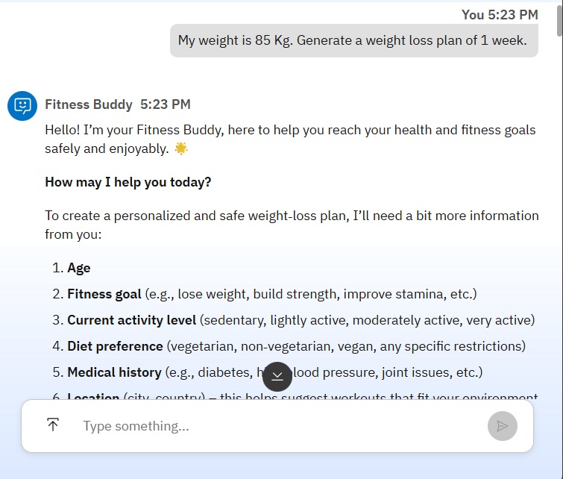
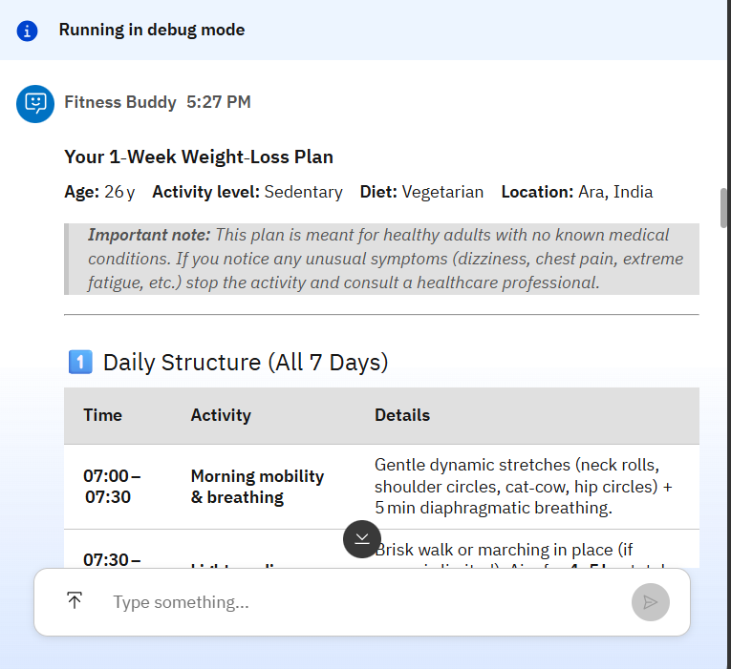
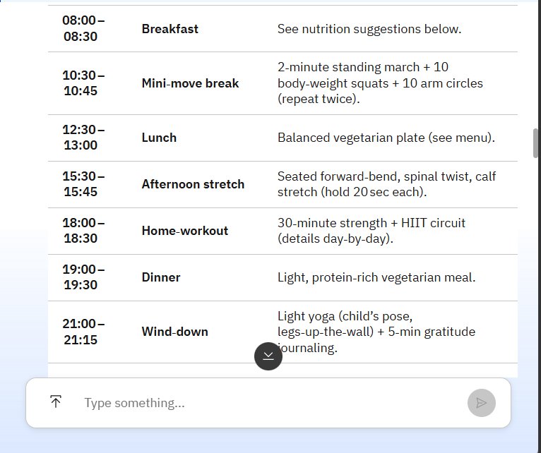
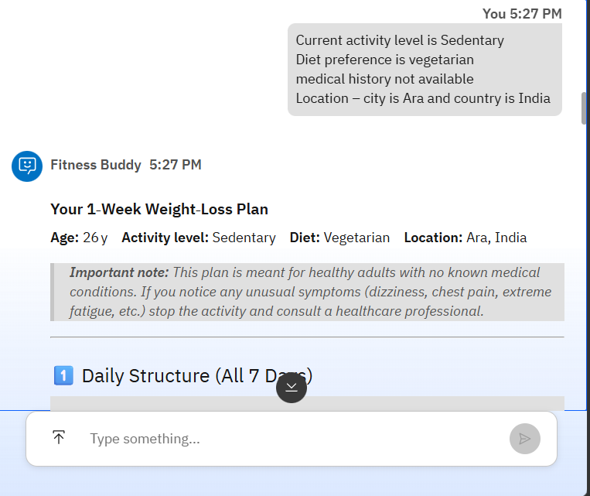
Screenshots:

Slide 7
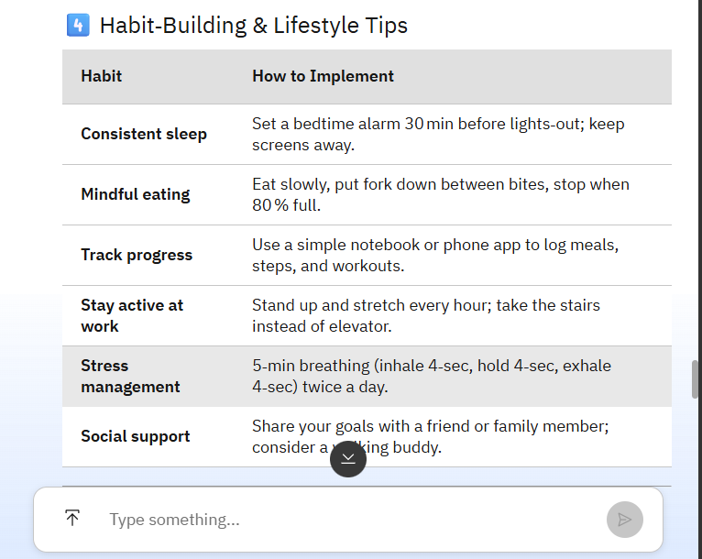
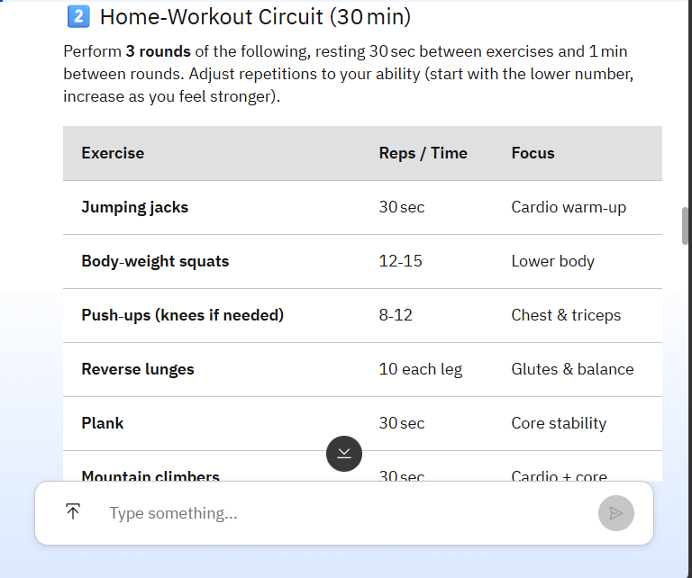
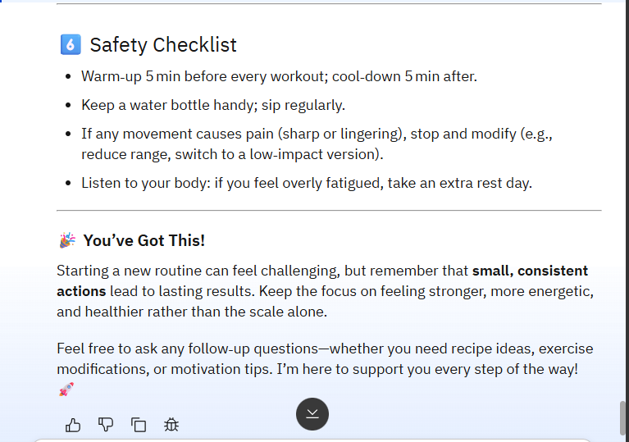
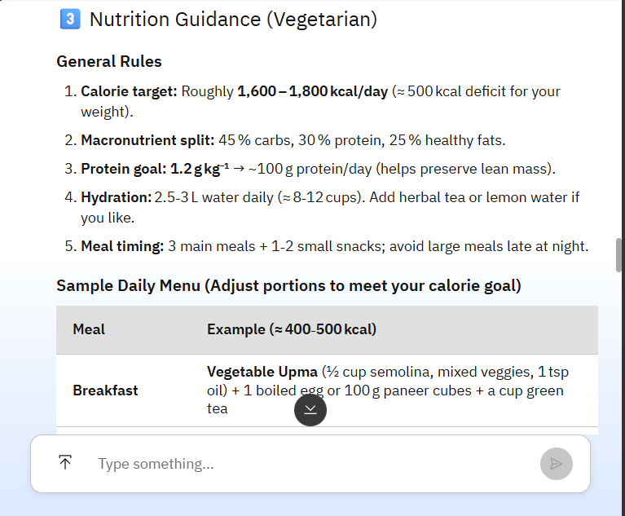
Screenshots:

Slide 8
Architecture Blueprint
Single-Agent Architecture on IBM Cloud Lite
LAYER 1 — USER INTERFACE
Web Browser
(HTML Page)
wxoLoader.js
(IBM Script)
Chat Widget
(Embedded)
HTTPS API Calls
LAYER 2 — IBM watsonx ORCHESTRATE
Fitness Buddy
Agent
Behavior
Instructions
Intent
Routing
Conversation
Memory
Auth &
IAM
LLM API Calls
LAYER 3 — IBM GRANITE LLM
IBM Granite
Foundation Model
NL Understanding
& Reasoning
Plan Generation
& Personalization
Motivation
& Tone Control
LAYER 4 — IBM CLOUD LITE
IAM & API Keys
au-syd Region
Instance
Cloud Object
Storage (Free)
API Gateway
& Security

Slide 9
Role of Agentic AI
How IBM watsonx Orchestrate enables intelligent, goal-driven fitness coaching
🧠 Autonomous Decision-Making
🎯 Goal-Driven Behavior
Agent independently determines what info to collect, which plan to generate, and when to apply guardrails — without manual routing.
Proactively guides users toward fitness goals by collecting required data before generating any plan, ensuring relevance.
Agentic
AI
Core
💬 Context Awareness
🔄 Real-Time Adaptation
Retains user profile (age, diet, medical history) throughout the conversation to deliver consistent, personalized responses.
Continuously adapts tone, recommendations, and motivation based on user feedback and changing inputs during the session.
Agentic AI makes Fitness Buddy proactive, personalized, and goal-driven — acting as a smart digital fitness coach, not just a static chatbot.

Slide 10
Technology Details
🤖 IBM watsonx Orchestrate
🧠 GPT-OSS-120B—OpenAI (Default LLM)
▸ Platform for building and deploying AI agents
▸ Foundation model powering the agent
▸ Single agent with behavior instructions
▸ Natural language understanding & reasoning
▸ Web chat widget with wxoLoader.js embed
▸ Personalized plan generation
▸ Hosted on IBM Cloud (au-syd region)
▸ Motivation & tone-aware responses
▸ AgentID: 9a497dbc-e774-4f20-a072-4c826379a0c0
▸ Deployed via watsonx.ai model serving
☁️ IBM Cloud Lite (Free Tier)
🌐 HTML + JS Frontend
▸ Free-tier IBM Cloud account used
▸ Single HTML file frontend
▸ watsonx Orchestrate Lite instance
▸ wxOConfiguration object setup
▸ IAM API Key for authentication
▸ wxoLoader.js injected dynamically
▸ CORS-compliant localhost deployment
▸ Python HTTP server for localhost
▸ au-syd.watson-orchestrate.cloud.ibm.com
▸ rootElementID: 'root' div mount

Slide 11
Novelty & Uniqueness
What makes Fitness Buddy stand out
🎯 Holistic Single-Agent Design
🛡️ Built-in Ethical AI Guardrails
Unlike multi-agent systems, Fitness Buddy achieves all 5 roles (workout, nutrition, motivation, habit-building, ethics) through a single expertly-crafted behavior instruction — simpler, faster, and more cost-effective on IBM Cloud Lite.
First-class HAM (Helpful, Accurate, Mindful) principles are embedded directly in the agent behavior. The agent proactively refuses medical diagnosis and ensures safe guidance — not as an afterthought, but by design.
🧑‍💼 Personalization Before Planning
💸 100% IBM Cloud Lite (Free)
Mandatory data collection (age, fitness goal, activity level, diet type, medical history) before any plan generation ensures every recommendation is truly personalized — not generic one-size-fits-all advice.
Entire solution runs on IBM Cloud Lite free tier — zero infrastructure cost. Makes it accessible for students and resource-constrained users while leveraging enterprise-grade AI.
🌐 Zero-Install Web Deployment
🤝 Responsible AI for Health Domain
No app to install, no account required for users. A simple HTML web page with the watsonx embed script gives instant access to the AI coach from any browser on any device.
Applies IBM's AI ethics framework to a sensitive health domain. Clear boundaries between fitness coaching and medical advice protect users while building trust in AI-driven health tools.

Slide 12
GitHub Repository
🔗 GitHub URL:
https://github.com/ashishraj-hub/Fitness_Buddy.git
1. Create a public GitHub repository with format: fitness-buddy-ibm-watsonx (enable Add README during creation)
📁 Required Files Checklist
✅
Fitness buddy.html
Frontend web page with watsonx Orchestrate web chat embed
✅
fitness-buddy-Submission.pptx
This project submission presentation
✅
README.md
Project description, setup instructions, and demo screenshots
✅
Fitness Buddy SS.pdf
Demo screenshots

Slide 13
Future Scope
Roadmap for enhancing Fitness Buddy
⌚ Wearable & Health Device Integration
Phase 2
🗣️ Voice Assistant & Multilingual Support
Phase 2
Connect with smartwatches (Apple Watch, Fitbit, Samsung Health) to collect real-time biometric data — steps, heart rate, calories burned, and sleep patterns — enabling dynamic, data-driven workout adjustments.
Add voice-enabled interaction using IBM Watson Speech-to-Text so users can speak their queries. Support 10+ languages for global accessibility, especially for non-English-speaking populations.
📊 Progress Dashboard & Analytics
Phase 3
🍽️ RAG-Based Nutrition Knowledge Base
Phase 3
Build a visual dashboard using IBM Cognos or a React frontend showing weekly workout completion, calorie trends, habit streaks, and goal progress — giving users tangible evidence of improvement.
Integrate a Retrieval-Augmented Generation pipeline with verified nutrition databases (USDA, WHO) stored in IBM Cloud Object Storage, enabling evidence-based dietary recommendations with source citations.
🏥 Healthcare Provider Integration
Phase 4
🤝 Multi-Agent Specialization
Phase 4
Partner with healthcare APIs to allow doctors to set fitness boundaries for patients with chronic conditions, with Fitness Buddy respecting those constraints during plan generation.
Evolve from single-agent to multi-agent architecture on watsonx Orchestrate — dedicated agents for workout planning, nutrition, mental wellness, and progress tracking — each specializing in their domain.

Slide 14


